Slide 1
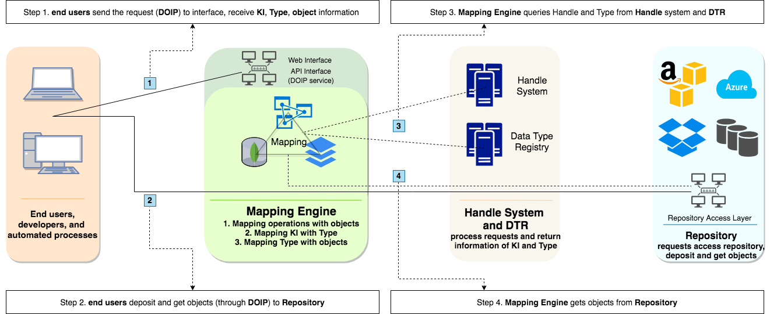
Enhanced Robust Persistent Identification of Data Testbed (ERPID)
The poster introduces the concepts of E-RPID testbed, describes the services that enable FAIR principles, introduces the utilization of Digital Object Architecture, and shows operations of testbed that enhance the data findability, accessibility and reusability.

